Slide 1


Text Summarization
Heriot Watt University , Dubai Campus 2019/2020

Slide 2

History
Initially pioneered by Hans Peter Luhn in 1950 at IBM.
Existence and availability of internet
Increase of amount of data
Need:
Important data time

Slide 3

Text Summarization

Slide 4

What is Text Summarization?

Slide 5
“Automatic text summarization is the task of using computers to
produce a concise and fluent summary while preserving key
information content and overall meaning ”
Text Summarization Techniques: A Brief Survey 2017

Slide 6
Types of Text Summarization
Extractive Summarization
Abstractive Summarization

Slide 7
Extractive Summarization
Extracting important complete sentences from text
No change in the sentences extracted
Document
Sentence 1
Sentence 2
Sentence 3
Sentence 4
Summary
Sentence 1
Sentence 4
Extractive

Slide 8

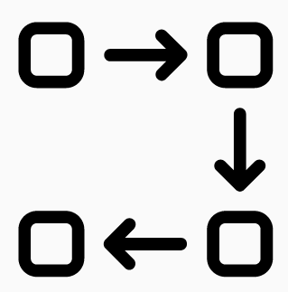
Extractive (How it is done?)
It is done in 3 phases:
Build representation of the text (Preprocessing)
Score sentences in built representation
Select k most important sentences to be our summary

Slide 9
Extractive (Preprocessing)
This phase involves four stages:
1. Sentence Segmentation
2. Tokenization
3. Stop word Removal
4. Stemming/Lemmetization
Article
Text
Sentences
Stem/Lemm
Stop word Remove
Words

Slide 10
Extractive (Representation)
Most common approaches:
1. Frequency based representation
2. Semantic similarity representation
3. Vector similarity representation
4. Graph based representation
Article
Text
Sentences
Representation
Vector
…
Graph

Slide 11
Extractive (Scoring)
After phase 1, sentences are scored based on factors such as frequency, semantics, similarity, position of sentence or word.

Slide 12
Extractive (Scoring) Contd.
Frequency based Scoring
If the number of times a word occurred in a document is high, then it has importance in the content of that document. Thus higher score.
Common methods used:
Word Probability
Bag of Words (BoW)
Term Frequency - Inverse Document Frequency (TF-IDF)

Slide 13
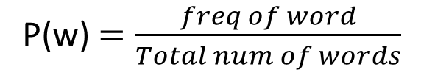
Frequency based Scoring (Word Probability)
Is the number of occurrences of a word divided by the total number of words.
P(w) $=\frac{freq of word}{Total num of words}$
Text Summarization Techniques: A Brief Survey 2017

Slide 14
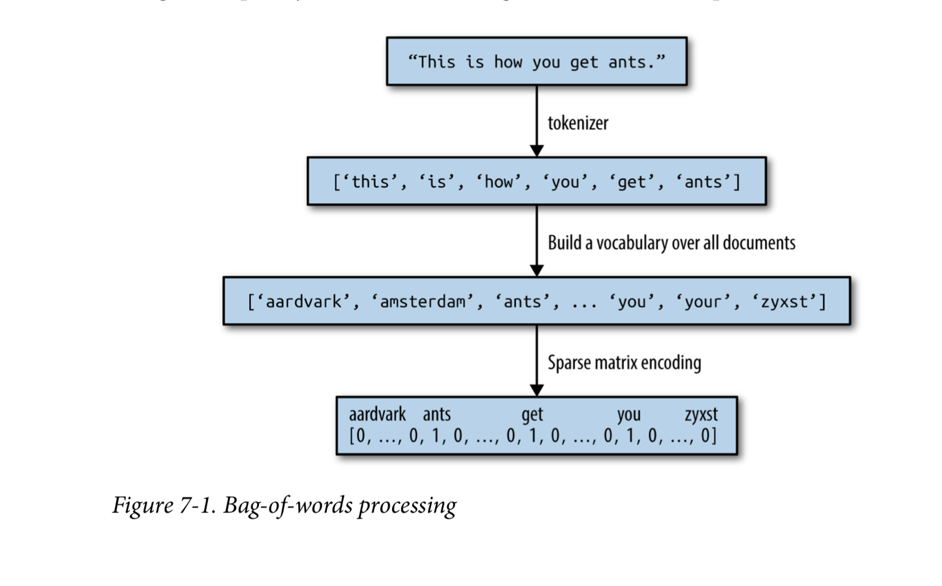
Frequency based Scoring (Bag of Words)
Bag of words is a vector with size equal to all words in our document. A BoW representation of a sentence is the the same vector with frequencies of words occurred in this sentence.

Slide 15
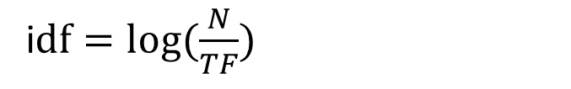
Frequency based Scoring (TF-IDF)
TF: number of documents contain t
IDF: total number of documents divided by documents containing t
i$df=log⁡(\frac{N}{TF})$

Slide 16
Extractive (Scoring) Contd.
Semantic based Scoring
LSA
LDA

Slide 17
Extractive (Scoring) Contd.
Similarity based Scoring
Vector rep. of sentence
Euclidian Dist or cosine dist.

Slide 20
Abstractive Summarization
Generate new sentences as a summarization
Sentences do not exist in original text
More human readable than extractive text summaries.
Document
Sentence 1
Sentence 2
Sentence 3
Sentence 4
Summary
New Sentence 1
New Sentence 2
Abstractive

Slide 21
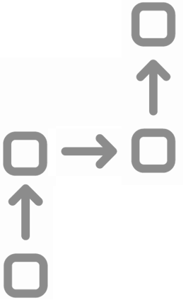
Abstractive (How it is done?)
It follows an Encoder-Decoder Architecture
Creates a Semantic/Structured representation of the text (Encoding)
Recreates the sentences from the Semantic/Structure representation (Decoding)

Slide 22
Abstractive (Encoding/Decoding)
Several types of neural networks are used as Encoders/Decoders:
Recurrent Neural Networks (RNNs)
Gated Recurrent Neural Network (GRU)
Long Short-Term Memory (LSTM)

Slide 23
Abstractive Encoding (How it is done?)
1. A chain of thee selected Neural networks (Node) are linked together
2. Each node takes an initialization value and the next word in the sentence.
3. The nodes feed their outputs as the initialization value for the next node.

Slide 24
Abstractive decoding (How it is done?)
A chain of the selected Neural networks (Node) are linked together.
Each node takes the output initialization value of the encoder chain as the initialization value for the decoder.
The decoder is given a Start token and predicts the next token as its output. This predicted token is taken as the input for the next node.
The sentence is summarized when a defined end token or word limit is reached.

Slide 25
Refrences
Gupta, Som & Gupta, S. K, 2019. Abstractive summarization: An overview of the state of the art. Expert Systems With Applications, 121, pp.49–65.

